Slide 1

Year 8: Probability
Dr J Frost (jfrost@tiffin.kingston.sch.uk)
Last modified: 14th January 2016

Slide 2
Recap: Probability Scale
0
0.5
1
Getting a Heads on the flip of a coin
Going to sleep tonight
Scoring 101% on a test
Winning the UK Lottery
A Tiffin student travelling to school by bus
Being left-handed

Slide 3
How to write probabilities
Probability of winning the UK lottery:
?
?
1 in 14,000,000
___1___
14000000
Odds Form
Fractional Form
?
0.000000714
?
0.0000714%
Decimal Form
Percentage Form
Which is best in this case?

Slide 4
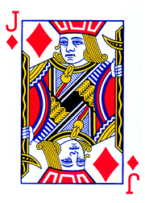
Calculating a probability
outcomes matching event
total outcomes
P(event) =
Probability of picking a Jack from a pack of cards?
_4_
52
?
?
P(Jack) =

Slide 5
Activity 1 (fill in on your exercise pack)
List out all the possible outcomes given each description, underline or circle the outcomes that match, and hence work out the probability.
The set of all possible outcomes is known as the sample space.
 | Event | Outcomes | Probability
1 | Getting one heads and one tails on the throw of two coins. | HH, HT, TH, TT | 1/2
2 | Getting two tails after two throws. | HH, HT, TH, TT | 1/4
3 | Getting at least 2 heads after 3 throws. | HHH, HHT, HTH, HTT, THH, THT, TTH, TTT | 1/2
4 | Getting exactly 2 heads after 3 throws. | HHH, HHT, HTH, HTT, THH, THT, TTH, TTT | 3/8
5 | Rolling a prime number and throwing a head. | 1H, 2H, 3H, 4H, 5H, 6H, 1T, 2T, 3T, 4T, 5T, 6T | 1/4
6 | In three throws of a coin, a heads never follows a tails. | HHH, HHT, HTH, HTT, THH, THT, TTH, TTT | 1/2
7 | For a randomly chosen meal with possible starters Avacado, Beans and Cauliflower, and possible main courses Dog, Escalopes or Fish, ending up with neither Avacado nor Dog. | AD, AE, AF, BD, BE, BF, CD, CE, CF | 4/9
?
?
?
?
?
?
?
?
?
?
?
?

Slide 6
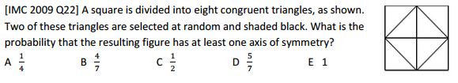

Puzzle!
Work on in pairs.
Hint: It might be easier to count those which are not symmetrical!
? Matching
$$=\frac{20}{28}$$
? Total outcomes
Hint: Can you use the ‘choose’ function?

Slide 7
Activity 2
Sometimes we can reason how many outcomes there will be without the need to list them.
 | Event | Num matching outcomes | Num total outcomes | Probability
1 | Drawing a Jack from a pack of cards. | 4 | 52 | P(J) = 4/52 = 1/13
2 | Drawing a club from a pack of cards. | 13 | 52 | P(Club) = 13/52 = 1/4
3 | Drawing a card which is either a club or is an even number. | 28 | 52 | P(even or club) = 7/13
4 | Throwing two sixes on a die in a row. | 1 | 36 | P(66) = 1/36
5 | Throwing an even number on a die followed by an odd number. | 9 | 36 | P(even-odd) = 1/4
6 | Throwing three square numbers on a die in a row. | 8 | 216 | P(three square) = 1/27
7 | Seeing exactly two heads in four throws of a coin. | 6 | 16 | P(two Heads) = 3/8
8 | Seeing the word ‘BOB’ when arranging two plastic Bs and an O on a sign. | 2 | 6 | P(BOB) = 1/3
N | Seeing the word LOLLY when arranging a letter O, Y and three letter Ls on a sign. | 6 | 120 | P(LOLLY) = 1/20
NN | After shuffling a pack of cards, the cards in each suit are all together. | 4! x (13!)⁴ | 52! | Roughly 1 in 2 billion billion billion.
?
?
?
?
?
?
?
?
?
?
?
?
?
?
?
?
?
?
?
?
?
?
?
?
?
?
?

Slide 8
Recap: Combinatorics
Combinatorics is the ‘number of ways of arranging something’.
We could consider how many things could do in each ‘slot’, then multiply these numbers together.
1
How many 5 letter English words could there theoretically be?
B
I
L
B
O
26 x 26 x 26 x 26 x 26 = 26⁵
?
2
How many 5 letter English words with distinct letters could there be?
S
M
A
U
G
26 x 25 x 24 x 23 x 22 = 7893600
?
3
How many ways of arranging the letters in SHELF?
E
L
F
H
S
5 x 4 x 3 x 2 x 1 = 5! (“5 factorial”)
?

Slide 9
Activity 3
For this activity, it may be helpful to have four cards, numbered 1 to 4.
 | Event | Num matching outcomes | Num total outcomes | Probability
1 | One number randomly picked being even. | 2 | 4 | P(Even) = 2/4
2 | The four numbers, when randomly placed in a line, reads 1-2-3-4 | 1 | 4! = 24 | P(1, 2, 3, 4) = 1/24
3 | Two numbers, when placed in a line, contain a two and a three. | 2 | 12 | P(2 with 3) = 1/6
4 | Three numbers, when placed in a line, form a descending sequence. | 3 | 24 | P(Descending) = 1/8
5 | Two numbers, when placed in a line, give a sum of 5. | 4 | 12 | P(Sum of 5) = 1/3
6 | When you pick a number out a bag, look at the value then put it back, then pick a number again, both numbers are 1. | 1 | 16 | P(1, 1) = 1/16
N | When you pick a number from a bag, put the number back, and do this 4 times in total, the values of your numbers form a ‘run’ of 1 to 4 in any order (e.g. 1234, 4231, ...). | 4! = 24 | 4⁴ = 256 | P(run) = 3/32
?
?
?
?
?
?
?
?
?
?
?
?
?
?
?
?
?
?
?
?
?
Notes:
Probably use this as a homework.

Slide 10
2D Sample Spaces
We previously saw that a sample space was the set of all possible outcomes.
Sometimes it’s more convenient to present the outcomes in a table.
Q: If I throw a fair coin and fair die, what is the probability I see a prime number or a tails?
1D Sample Space
2D Sample Space
?
Ensure you label your ‘axis’.
{ H1, H2, H3, H4, H5, H6, T1, T2, T3, T4, T5, T6 }
P(prime or T) = 9/12
Die
 | 1 | 2 | 3 | 4 | 5 | 6
H | H1 | H2 | H3 | H4 | H5 | H6
T | T1 | T2 | T3 | T4 | T5 | T6
Coin
P(prime or T) = 9/12

Slide 11
2D Sample Spaces
Suppose we roll two ‘fair’ dice, and add up the scores from the two dice.
What’s the probability that:
My total is 10? 3/36 = 1/12
My total is at least 10? 6/36 = 1/6
My total is at most 9? 5/6
?
?
?
Second Dice
Three of the outcomes match the event “total is 10”. And there’s 36 outcomes in total.
+ | 1 | 2 | 3 | 4 | 5 | 6
1 | 2 | 3 | 4 | 5 | 6 | 7
2 | 3 | 4 | 5 | 6 | 7 | 8
3 | 4 | 5 | 6 | 7 | 8 | 9
4 | 5 | 6 | 7 | 8 | 9 | 10
5 | 6 | 7 | 8 | 9 | 10 | 11
6 | 7 | 8 | 9 | 10 | 11 | 12
?
?
?
?
?
?
?
First Dice
“At most 9” is like saying “NOT at least 10”. So we can subtract the probability from 1.

Slide 12
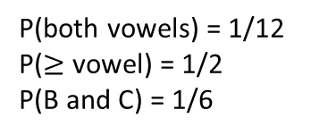
Exercise 4
1
After throwing 2 fair coins.
3
After throwing 2 fair die and multiplying.
?
2nd Coin
?
x | 1 | 2 | 3 | 4 | 5 | 6
1 | 1 | 2 | 3 | 4 | 5 | 6
2 | 2 | 4 | 6 | 8 | 10 | 12
3 | 3 | 6 | 9 | 12 | 15 | 18
4 | 4 | 8 | 12 | 16 | 20 | 24
5 | 5 | 10 | 15 | 20 | 25 | 30
6 | 6 | 12 | 18 | 24 | 30 | 36
2nd Coin
 | H | T
H | HH | HT
T | TH | TT
P(product 6) = 1/9
P(product <= 6) = 7/18
P(product >= 7) = 11/18
P(product odd) = 1/4
1st Coin
1st Coin
?
1st Die
?
?
?
P(HH) = 1/4
P(H and T) = 1/2
?
?
2
After throwing 2 fair die and adding.
4
After spinning two spinners, one A, B, C and one A, B, C, D.
?
2nd Die
2nd Coin
+ | 1 | 2 | 3 | 4 | 5 | 6
1 | 2 | 3 | 4 | 5 | 6 | 7
2 | 3 | 4 | 5 | 6 | 7 | 8
3 | 4 | 5 | 6 | 7 | 8 | 9
4 | 5 | 6 | 7 | 8 | 9 | 10
5 | 6 | 7 | 8 | 9 | 10 | 11
6 | 7 | 8 | 9 | 10 | 11 | 12
2nd Spinner
?
 | A | B | C | D
A | AA | AB | AC | AD
B | BA | BB | BC | BD
C | CA | CB | CC | CD
P(total prime) = 15/36
P(total < 4) = 1/12
P( total odd) = 1/2
1st Coin
?
?
1st Spinner
1st Die
?
P(both vowels) = 1/12
P($≥$ vowel) = 1/2
P(B and C) = 1/6
?
?
?

Slide 13
Events and Mutually Exclusive Events
Examples of events:
Throwing a 6, throwing an odd number, tossing a heads, a randomly chosen person having a height above 1.5m.
An event in probability is a description of one or more outcomes.
(More formally, it is any subset of the sample space)
We often represent an event using a single capital letter, e.g. P(A) = 2/3.
?
?
If two events A and B are mutually exclusive, then they can’t happen at the same time, and:
P(A or B) = P(A) + P(B)
?
You may recall from the end of Year 7, when we covered Set Theory, that A ∪ B meant “you are in set A, or in set B”. Since events are just sets of outcomes, we can formally write P(A or B) as P(A ∪ B).

Slide 14
Events not happening
A’ means that A does not happen.
P(A’) = 1 – P(A)
?
Quick practice:
1
A and B are mutually exclusive events and P(A) = 0.3, P(B) = 0.2
P(A or B) = 0.5,
P(A’) = 0.7,
P(B’) = 0.8
C and D are mutually exclusive events and P(C’) = 0.6, P(D) = 0.1
P(C or D) = 0.5
E, F and G are mutually exclusive events and P(E or F) = 0.6 and P(F or G) = 0.7 and P(E or F or G) = 1
P(F) = 0.3
P(E) = 0.3
P(G) = 0.4
?
?
?
2
?
3
?
?
?

Slide 15
Test your understanding
A bag consists of red, blue and green balls. The probability of picking a red ball is 1/3 and a blue ball 1/4. What is the probability of picking a green ball?
P(R) = 5/12
An unfair spinner is spun. The probability of getting A, B, C and D is indicated in the table below.
Determine x.
A | B | C | D
0.1 | x | 0.4 | x
?
A
B
D
C
x = 0.25
?

Slide 16
Exercise 5 (on your sheet)
1
In the following questions, all events are mutually exclusive.
P(A) = 0.6, P(C) = 0.2 P(A’) = 0.4, P(C’) = 0.8 P(A or C) = 0.8
P(A) = 0.1, P(B’) = 0.8, P(C’) = 0.7 P(A or B or C) = 0.1 + 0.2 + 0.3 = 0.6
P(A or B) = 0.3, P(B or C) = 0.9, P(A or B or C) = 1 P(A) = 0.1 P(B) = 0.2 P(C) = 0.7
P(A or B or C or D) = 1. P(A or B or C) = 0.6 and P(B or C or D) = 0.6 and P(B or D) = 0.45 P(A) = 0.4, P(B)= 0.05 P(C) = 0.15, P(D) = 0.4
2
All Tiffin students are either good at maths, English or music, but not at more than one subject. The probability that a student is good at maths is 1/5. The probability they are are good at English is 1/3. What is the probability that they are good at music?
P(Music) = 7/15
The probability that Alice passes an exam is 0.3. The probability that Bob passes the same exam s 0.4. The probability that either pass is 0.65. Are the two events mutually exclusive? Give a reason.
No, because 0.3 + 0.4 = 0.7 is not 0.65.
a
?
?
?
b
?
c
?
?
3
?
?
d
?
?
?
?
?

Slide 17
Exercise 5 (on your sheet)
The following tables indicate the probabilities for spinning different sides, A, B, C and D, of an unfair spinner. Work out x in each case.
x = 0.3
x = 0.1
x = 0.1
x = 0.15
5
I am going on holiday to one destination this year, either France, Spain or America. I’m 3 times as likely to go to France as I am to Spain but half as likely to go to America than Spain. What is the probability that I don’t go to Spain?
Probabilities of could be expressed as:
So 4.5x = 1, so x = 2/9
So P(not Spain) = 7/9
P(A or B or C) = 1. P(A or B) = 4x – 0.1 and P(B or C) = 4x. Determine expressions for P(A), P(B) and P(C), and hence determine the range of values for x.
P(C) = 1 – P(A or B) = 1 – (4x – 0.1) = 1.1 – 4x
P(A) = 1 – P(B or C) = 1 – 4x
P(B) = (4x – 0.1) + (4x) – 1 = 8x – 1.1
Since probabilities must be between 0 and 1, from P(A), x must be between 0 and 0.25. From P(B), x must be between 0.1375 and 0.2625. From P(C), x must be between 0.025 and 0.275. Combining these together, we find that
0.1375 ≤ x ≤ 0.25
4
A | B | C | D
0.1 | 0.3 | x | x
?
France | Spain | America
3x | x | 0.5x
?
A | B | C | D
0.5 | 2x | 0.2 | x
N
?
A | B | C | D
x | 2x | 3x | 4x
?
?
A | B
x | 4x + 0.25
?

Slide 18

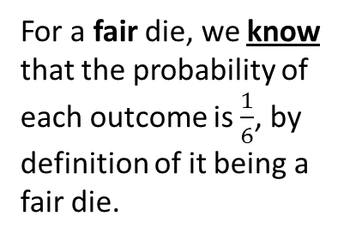

How can we find the probability of an event?
1. We might just know!
2. We can do an experiment and count outcomes
We could throw the dice 100 times for example, and count how many times we see each outcome.
For a fair die, we know that the probability of each outcome is $\frac{1}{6}$, by definition of it being a fair die.
Outcome | 1 | 2 | 3 | 4 | 5 | 6
Count | 27 | 13 | 10 | 30 | 15 | 5
?
R.F. | $$\frac{27}{100}$$ | $$\frac{13}{100}$$ | $$\frac{10}{100}$$ | $$\frac{30}{100}$$ | $$\frac{15}{100}$$ | $$\frac{5}{100}$$
This is known as a:
This is known as an:
Theoretical Probability
Experimental Probability
When we know the underlying probability of an event.
Also known as the relative frequency , it is a probability based on observing counts.
$$p\left(event\right)=\frac{count of outcome}{number of trials}$$
?
?

Slide 19
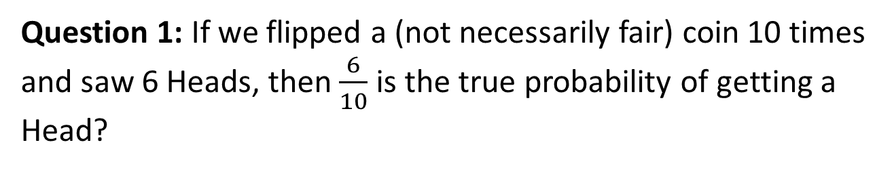
Check your understanding
Question 1: If we flipped a (not necessarily fair) coin 10 times and saw 6 Heads, then $\frac{6}{10}$ is the true probability of getting a Head?
?
No. It might for example be a fair coin: If we throw a fair coin 10 times we wouldn’t necessarily see 5 heads. In fact we could have seen 6 heads! So the relative frequency/experimental probability only provides a “sensible guess” for the true probability of Heads, based on what we’ve observed.
Question 2: What can we do to make the experimental probability be as close as possible to the true (theoretical) probability of Heads?
?
Flip the coin lots of times. I we threw a coin just twice for example and saw 0 Heads, it’s hard to know how unfair our coin is. But if we threw it say 1000 times and saw 200 heads, then we’d have a much more accurate probability.
The law of large events states that as the number of trials becomes large, the experimental probability becomes closer to the true probability.

Slide 20

Excel Demo!

Slide 21
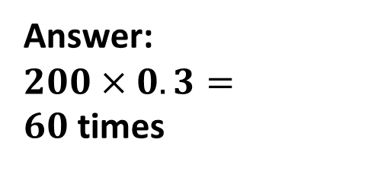
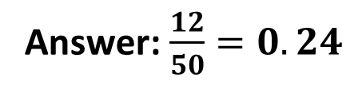
Estimating counts and probabilities
A spinner has the letters A, B and C on it. I spin the spinner 50 times, and see A 12 times. What is the experimental probability for P(A)?
?
Answer: $\frac{12}{50}=0.24$
The probability of getting a 6 on an unfair die is 0.3. I throw the die 200 times. How many sixes might you expect to get?
Answer:
$200×0.3=60$times
?

Slide 22
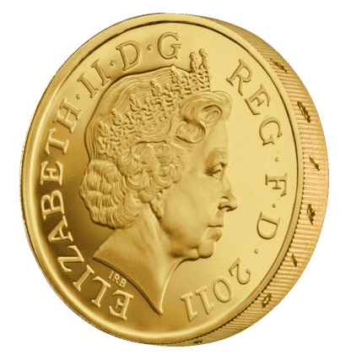
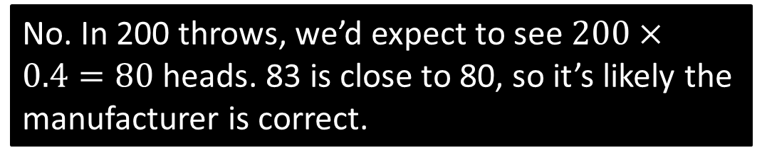
Estimating counts and probabilities
The Royal Mint (who makes British coins) claims that the probability of throwing a Heads is 0.4.
Athi throws the coin 200 times and sees 83 Heads. He claims that the manufacturer is wrong.
Do you agree? Why?
?
No. In 200 throws, we’d expect to see $200×0.4=80$ heads. 83 is close to 80, so it’s likely the manufacturer is correct.

Slide 23
Test Your Understanding
A
The table below shows the probabilities for spinning an A, B and C on a spinner. If I spin the spinner 150 times, estimate the number of Cs I will see.
Outcome | A | B | C
Probability | 0.12 | 0.34
A
B
C
?
P(C) = 1 – 0.12 – 0.34 = 0.54
Estimate Cs seen = 0.54 x 150 = 81
B
I spin another spinner 120 times and see the following counts:
What is the relative frequency of B?
45/120 = 0.375
Outcome | A | B | C
Count | 30 | 45 | 45
A
B
C
?

Slide 24
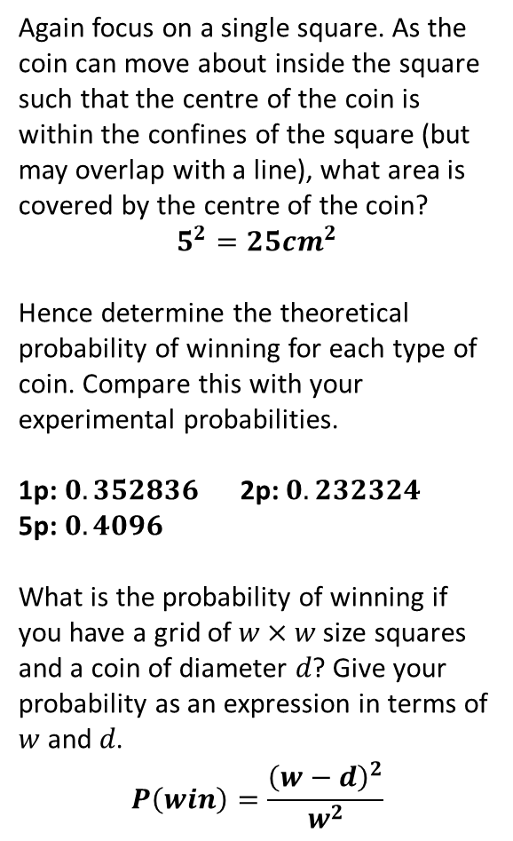

Coin Activity
See worksheet
c
Again focus on a single square. As the coin can move about inside the square such that the centre of the coin is within the confines of the square (but may overlap with a line), what area is covered by the centre of the coin?
$$5^{2}=25cm^{2}$$
Hence determine the theoretical probability of winning for each type of coin. Compare this with your experimental probabilities.
1p: $0.352836$ 2p: $0.232324$
5p: $0.4096$
What is the probability of winning if you have a grid of $w×w$ size squares and a coin of diameter $d$? Give your probability as an expression in terms of $w$ and $d$.
$$P\left(win\right)=\frac{{\left(w−d\right)}^{2}}{w^{2}}$$
TASK 1
Find the experimental probability that you will win when a 1p coin is thrown. Repeat with a 2p coin.
TASK 2
Measure the diameter of your coins:
Focus on a single square on the grid. As the coin can move about inside the square such that you win, what area is covered by the centre of the coin?
1p: $8.8209cm^{2}$ 2p: $5.8081cm^{2}$
5p: $10.24cm^{2}$
?
a
Coin | 1p | 2p | 5p
Diameter | 2.03cm | 2.59cm | 1.80cm
d
?
b
?
N
?
?

Slide 25
Exercise 6 (on your sheet)
An unfair die is rolled 80 times and the following counts are observed.
Determine the relative frequency of each outcome.
Dr Bob claims that the theoretical probability of rolling a 3 is 0.095. Is Dr Bob correct? He is probably correct, as the experimental probability/relative frequency is close to the theoretical probability.
An unfair coin has a probability of heads 0.68. I throw the coin 75 times. How many tails do I expect to see?
P(T) = 1 – 0.68 = 0.32
0.32 x 75 = 24
3
Dr Laurie throws a fair die 600 times, and sees 90 ones.
Calculate the relative frequency of throwing a 1. 90 / 600 = 0.15
Explain how Laurie can make the relative frequency closer to a sixth. Throw the die more times.
The table below shows the probabilities of winning different prizes in the gameshow “I’m a Tiffinian, Get Me Outta Here!”. 160 Tiffin students appear on the show. Estimate how many cuddly toys will be won.
x = (1 – 0.37 – 0.18)/3 = 0.15
0.15 x 160 = 24 cuddly toys
1
Outcome | 1 | 2 | 3 | 4 | 5 | 6
Count | 20 | 10 | 8 | 4 | 10 | 28
R.F. | 0.25 | 0.125 | 0.1 | 0.05 | 0.125 | 0.35
?
?
?
?
4
2
?
Prize | Cockroach Smoothie | Cuddly Toy | Maths Textbook | Skip Next Landmark
Prob | 0.37 | x | 0.18 | 2x
?

Slide 26
Exercise 6 (on your sheet)
5
A six-sided unfair die is thrown n times, and the relative frequencies of each outcome are 0.12, 0.2, 0.36, 0.08, 0.08 and 0.16 respectively. What is the minimum value of n?
All the relative frequencies are multiples of 0.04 = 1/25. Thus the die was known some multiple of 25 times, the minimum being 25.
A spin a spinner with sectors A, B and C 200 times. I see twice as many Bs as As and 40 more Cs than As. Calculate the relative frequency of spinning a C.
Counts are x, 2x and x + 40
Thus x + 2x + x + 40 = 200
4x + 40 = 200. Solving, x = 40.
Relative frequency = 80 / 200 = 0.4.
7
I throw a fair coin some number of times and the relative frequency of Heads is 0.45. I throw the coin a few more times and the relative frequency is now equal to the theoretical probability. What is the minimum number of times the coin was thrown?
If relative frequency is 0.45 = 9/20, the minimum number of times the coin was thrown is 20. If we threw two heads after this, the new relative frequency would be 11/22 = 0.5 (i.e. the theoretical probability)
Thus the minimum number of throws is 22.
I throw an unfair coin n times and the relative frequency of Heads is 0.35. I throw the coin 10 more times, all of which are Heads (just by luck), and the relative frequency rises to 0.48. Determine n. [Hint: Make the number of heads after the first throws say , then form some equations]
k/n = 0.35, which we can write as k = 0.35n.
(k+10)/(n+10) = 0.48, which we can rewrite as
k = 0.48n – 5.2 (i.e. by making k the subject)
Thus 0.35n = 0.48n – 5.2. Solving, n = 40.
?
?
6
8
?
?

Slide 27
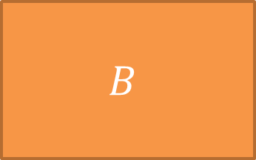



REVISION!
Vote with the coloured cards in your diaries (use the front for blue)
$$A$$
$$B$$
$$C$$
$$D$$

Slide 28
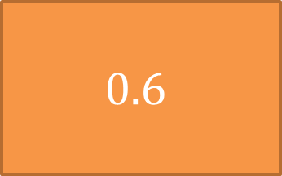
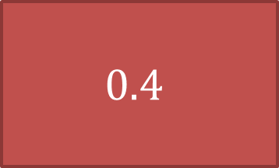


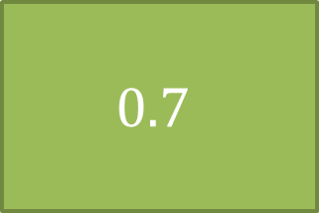
$A$ and $B$ are mutually exclusive events.
$P\left(A or B\right)=0.7$, and $P\left(A\right)=0.3$
What is $P(B^{′})$?
$$0.4$$
$$0.6$$
$$0.7$$
$$1$$

Slide 29
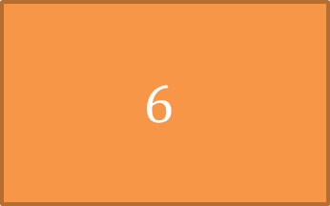
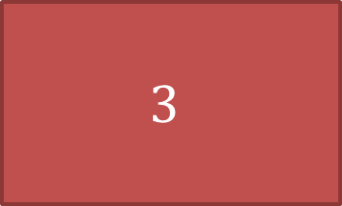


I throw a coin 3 times. How many possible outcomes are there?
$$3$$
$$6$$
$$8$$
$$9$$

Slide 30
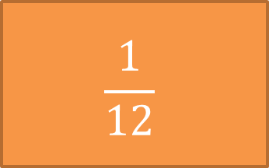
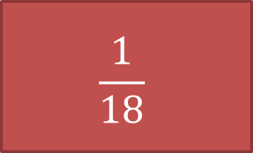
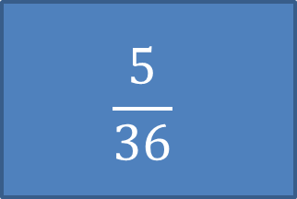
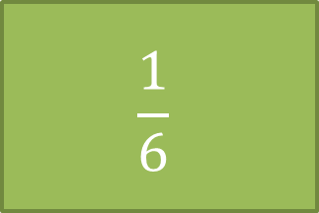
I throw two dice and add the scores. What’s the probability my sum is less than 4?
$$\frac{1}{18}$$
$$\frac{1}{12}$$
$$\frac{1}{6}$$
$$\frac{5}{36}$$

Slide 31
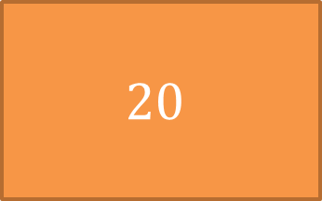
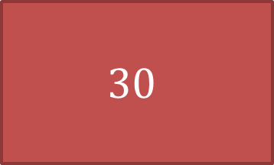
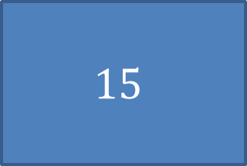

The table shows the probabilities of each outcome of an unfair 4-sided spinner. If I spin the spinner 150 times, how many times do I expect to see D on average?
A | B | C | D
0.3 | 0.1 | 0.5
$$30$$
$$20$$
$$10$$
$$15$$

Slide 32
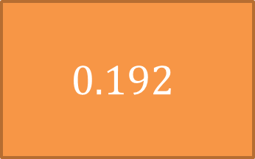
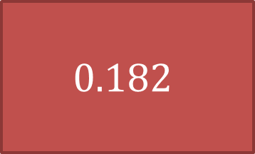
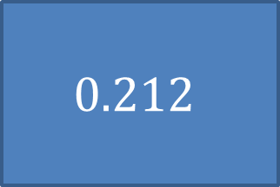
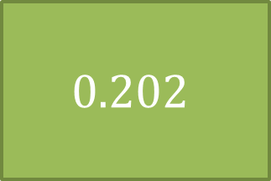
Bob buys a very expensive ‘perfectly fair’ die for use in his casino. He throws it 120 times and sees 23 ones. What’s the relative frequency of throwing a one?
$$0.182$$
$$0.192$$
$$0.202$$
$$0.212$$

Slide 33



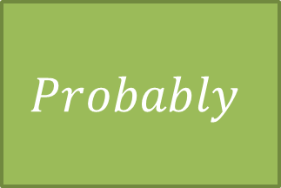
Bob buys a very expensive ‘perfectly fair’ die for use in his casino. He throws it 120 times and sees 23 ones.
Is the manufacturer’s claim that the die is fair correct?
$$Yes$$
$$No$$
$$Probably$$
$$Probably$$
$$Not$$

Slide 34
Look at the following table showing the number of 100 boys and girls in a school doing geography and history for GCSE. No student is allowed to do both.
 | Geography | History | Total
Boys | 35 | 25 | 60
Girls | 10 | 30 | 40
Total | 45 | 55 | 100

Slide 35
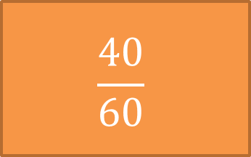
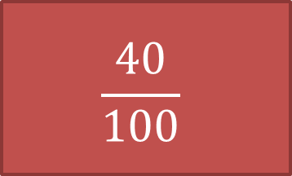
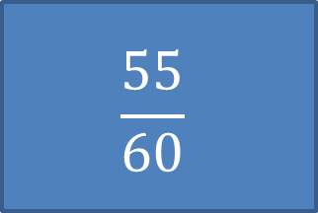
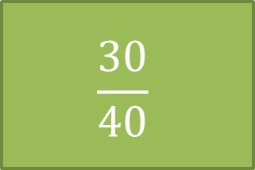
 | Geography | History | Total
Boys | 35 | 25 | 60
Girls | 10 | 30 | 40
Total | 45 | 55 | 100
What is the probability that a randomly chosen student is a girl?
$$\frac{40}{100}$$
$$\frac{40}{60}$$
$$\frac{30}{40}$$
$$\frac{55}{60}$$

Slide 36
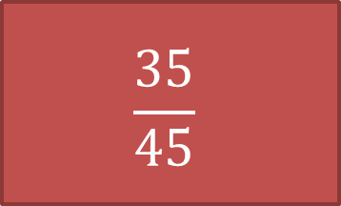
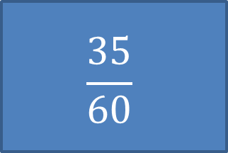
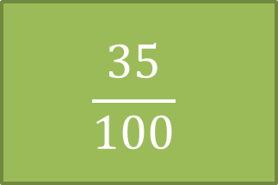
 | Geography | History | Total
Boys | 35 | 25 | 60
Girls | 10 | 30 | 40
Total | 45 | 55 | 100
What is the probability that a randomly chosen student is a boy who studies geography?
$$\frac{35}{45}$$
$$\frac{40}{60}$$
$$\frac{35}{100}$$
$$\frac{35}{60}$$

Slide 37
 | Geography | History | Total
Boys | 35 | 25 | 60
Girls | 10 | 30 | 40
Total | 45 | 55 | 100
Given a boy is chosen, what is the probability they chose geography?
$$\frac{35}{45}$$
$$\frac{40}{60}$$
$$\frac{35}{100}$$
$$\frac{35}{60}$$

Slide 38
 | Geography | History | Total
Boys | 35 | 25 | 60
Girls | 10 | 30 | 40
Total | 45 | 55 | 100
Given a someone who chose geography is chosen at random, what is the probability that they are a boy?
$$\frac{35}{45}$$
$$\frac{40}{60}$$
$$\frac{35}{100}$$
$$\frac{35}{60}$$

Slide 39


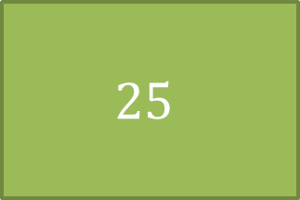
I throw an unfair die some number of times. I calculate the experimental probabilities of each outcome to be 0.04, 0.36, 0.12, 0.2, 0, 0.28.
What’s the minimum number of times I threw the die?
$$100$$
$$20$$
$$25$$
$$You can^{′}t$$
$$tell$$

Slide 40
I throw an unfair die some number of times. I calculate the experimental probabilities of each outcome to be 0.15, 0.2, 0.05, 0.3, 0, 0.3.
What’s the minimum number of times I threw the die?
$$100$$
$$20$$
$$25$$
$$You can^{′}t$$
$$tell$$

